Slide 1
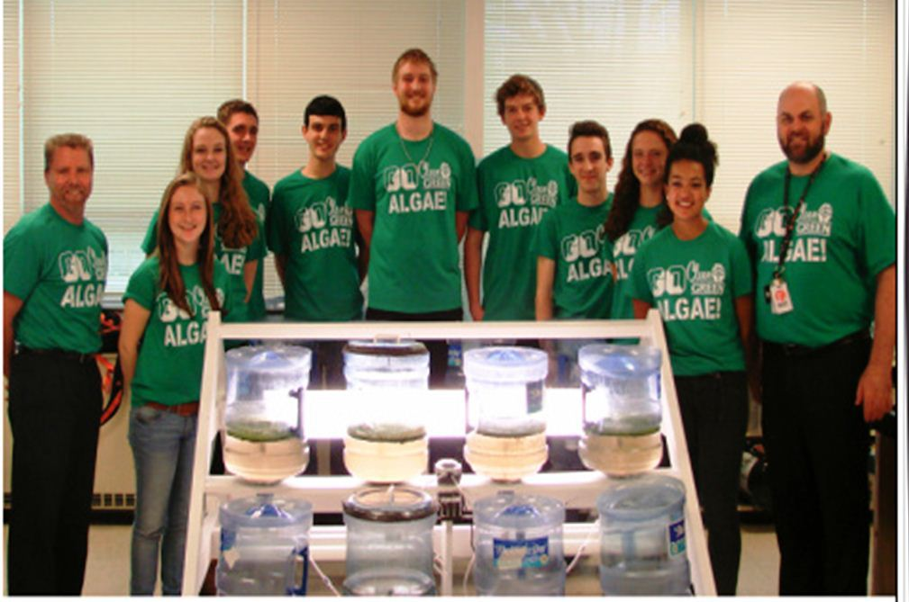
Why Algae?
An investigation into algae-based biofuel

Slide 2
Fossil Fuels
Fuels composed of the organic remains of ancient plants and animals
Coal
Crude Oil (Petroleum)
Natural Gas
Advantages
High amounts of chemical energy
Infrastructure and drilling techniques are
well established.
Disadvantages
Nonrenewable
Pollution

Slide 3
Fossil Fuel Consumption
The Energy Information Administration estimated in 2011 that the US’s primary sources consisted of
Petroleum: 40%
Coal: 23%
Natural Gas: 22%
Nuclear: 8%
AMOUNTING TO
93% total use of nonrenewable fuels
We are very dependent on nonrenewable resources

Slide 4
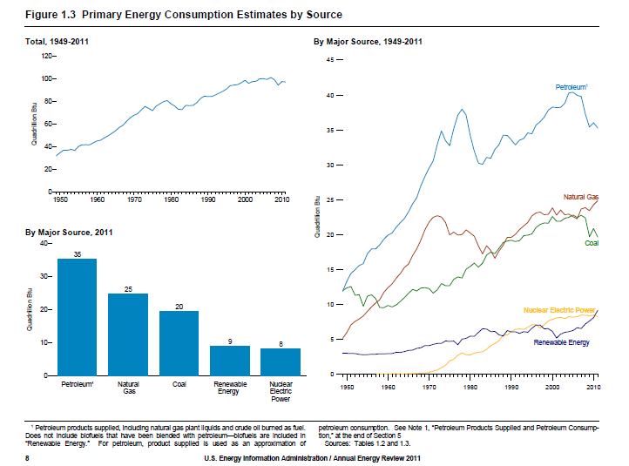
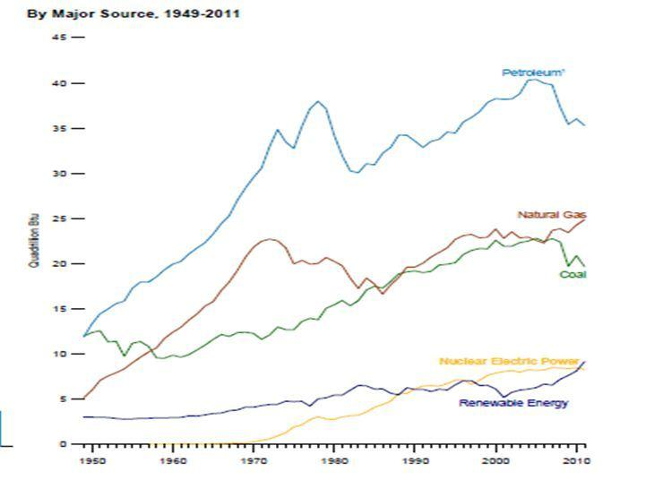

Slide 5
What’s the problem with dependence?
Fossil fuels are NONRENEWABLE; they will run out
We’ve known we’ve been running out of fossil fuels since the 1990s
We still haven’t done anything about it
British Petroleum
Statistical Review of World Energy shows that the world still has enough “proven” reserves to provide forty more years worth of consumption at the current rate
OUR GENERATION NEEDS TO TAKE A STAND
MAKE A CHANGE, ENJOY RETIREMENT

Slide 6
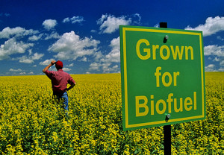
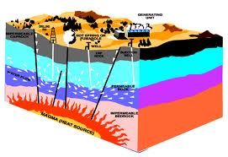
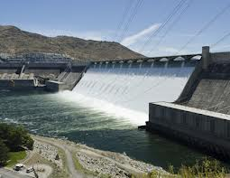
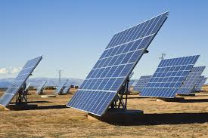
The Solution….
Renewable Energy!

Slide 7
Renewable Energy
Accounts for 7% of total U.S. energy consumption
Solar (.1%)
Makes energy from sunlight, but no potential for future improvement
Wind (.3%)
Depends on location
Hydroelectric (2.9%)
Depends on flowing water
Geothermal (.4%)
Expensive, not feasible on a high school level
Biofuel (.8%)
Young industry, huge potential
Other (2.5%)

Slide 9
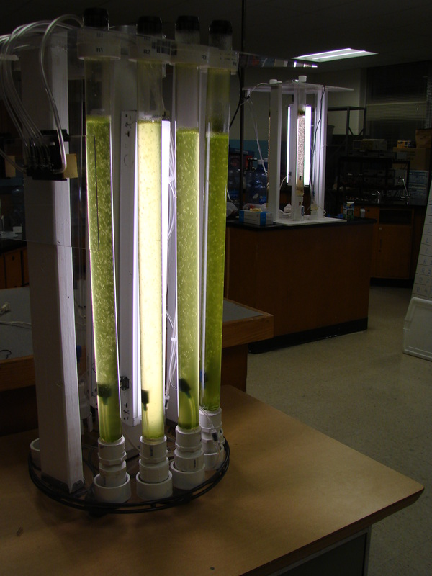
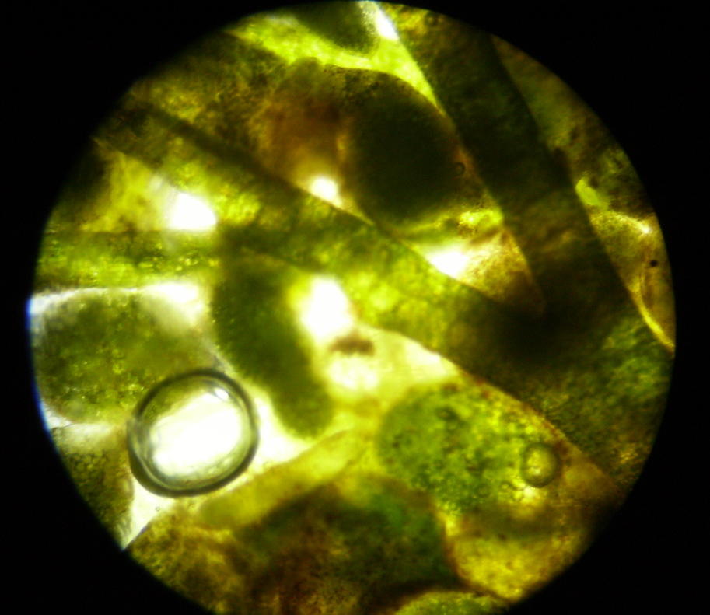
The Solution…
Biofuel!

Slide 10
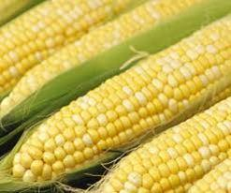
Corn
Ethanol – most common biofuel
Limitations
Space
Single Harvest
Seasonal
Climate

Slide 11
Other Biofuels
Plant | Yields( gallons per acre per year)
Corn | 18
Soybeans | 48
Safflower | 83
Sunflower | 102
Rapeseed | 127
Palm | 623
Algae | 5,000-15,000

Slide 12
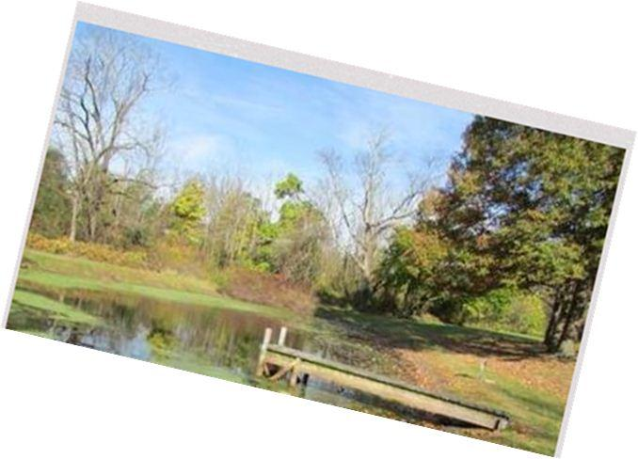
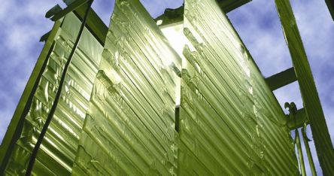
Benefits of Algae
Algae
Very efficient and fast producing source of fuel
Under optimal condition, can double quantity in 24 hours
Extremely abundant
Algae can produce approximately 100 times more fuel per acre than other renewable resources
Vertigro vs. Pond
Controlled vs. Open

Slide 13
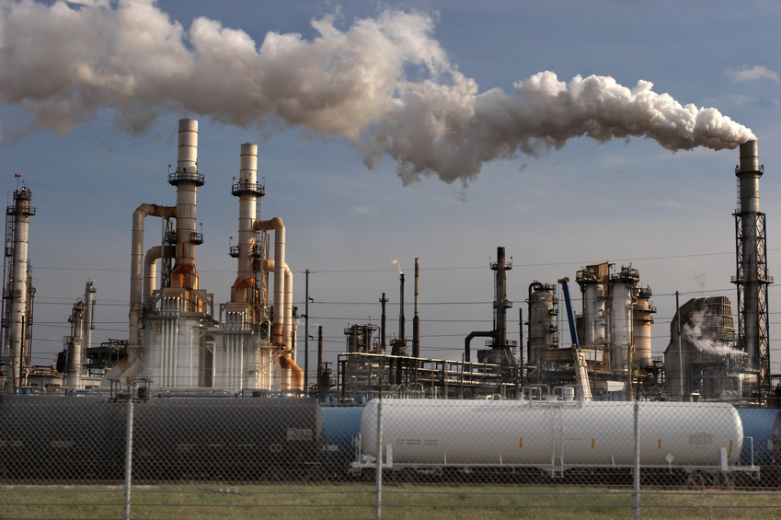
More Benefits
Able to control factors
Light
Water Temperature
Fertilizers
Carbon Dioxide or Oxygen
Carbon Sequestering
Uses Carbon Dioxide from its environment
Reduces Carbon Dioxide emission by 50%-70%

Slide 15
Benefits of Biodiesel Over Diesel
Biodiesel can be produced in the U.S
Decreases dependence on foreign oil
Air Quality
Using biodiesel in conventional biodiesel engines substantially reduces tailpipe emissions
CO, hydrocarbons, particulate matter
Enhances Engine Operation
Lipid oils lubricate engine, preventing premature wear
Safety
Nontoxic, less combustible (lower flashpoint), safe to environment

Slide 16
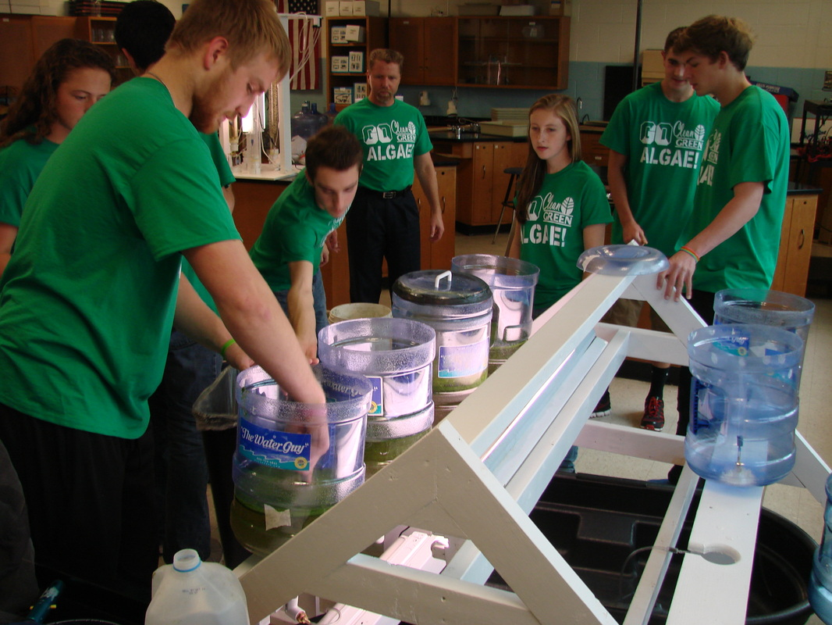
How We Began
Started as a research project
Researched benefits of biofuel, algae
Different kinds of algae
Best environment for algae growth
Decided to take it to the next level
Physically building the reactor
Money and Grants
Time/communication
Construction

Slide 17
Importance
Raise awareness
Educate the community
Save our future
Economic impacts
Supply/demand
STEM Careers
Rapidly growing
Change the world

Slide 18
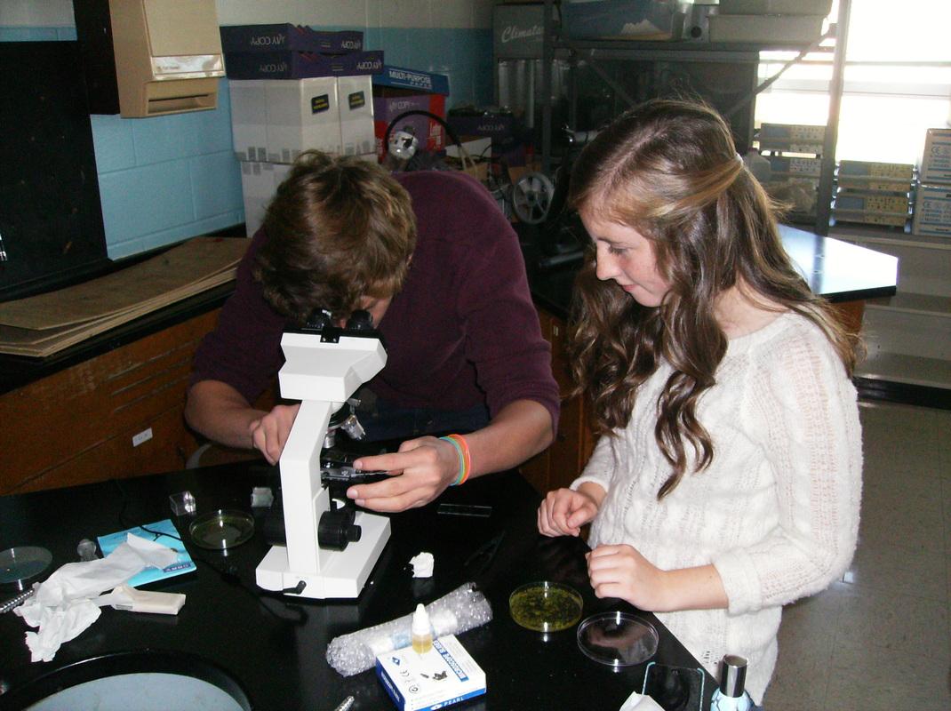
Accomplishments
Research
Construction
Algae collection
Biodiesel production
Informed the public
Working with others

Slide 19
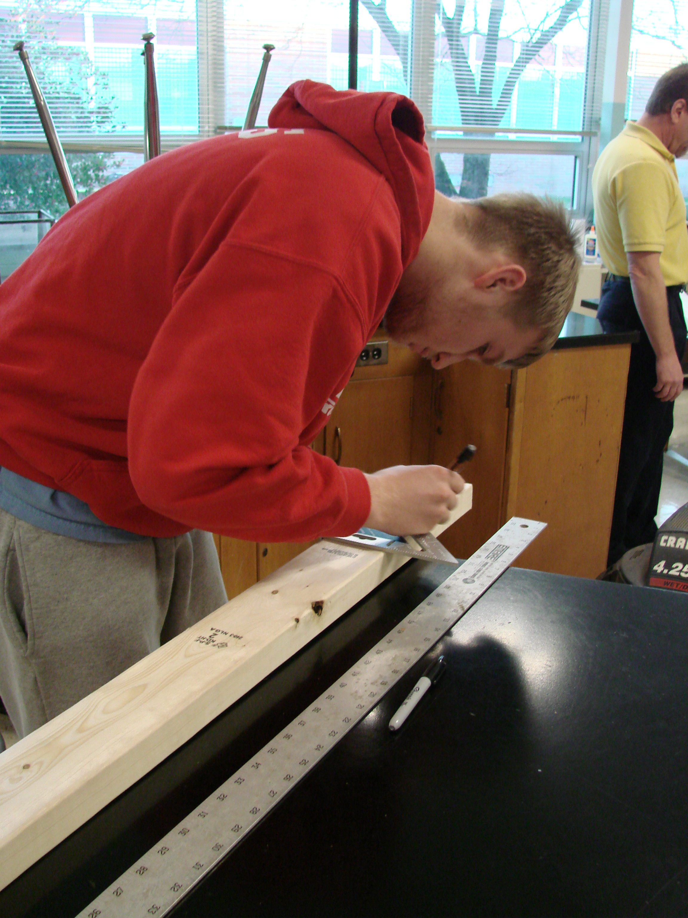
Completed Goals
Research
Construction
Algae collection
Biodiesel production
Informed the public
Working with others

Slide 20
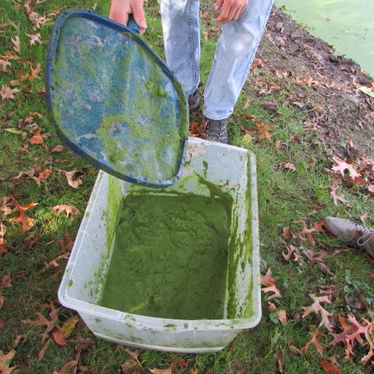
Completed Goals
Research
Construction
Algae collection
Biodiesel production
Informed the public
Working with others

Slide 21
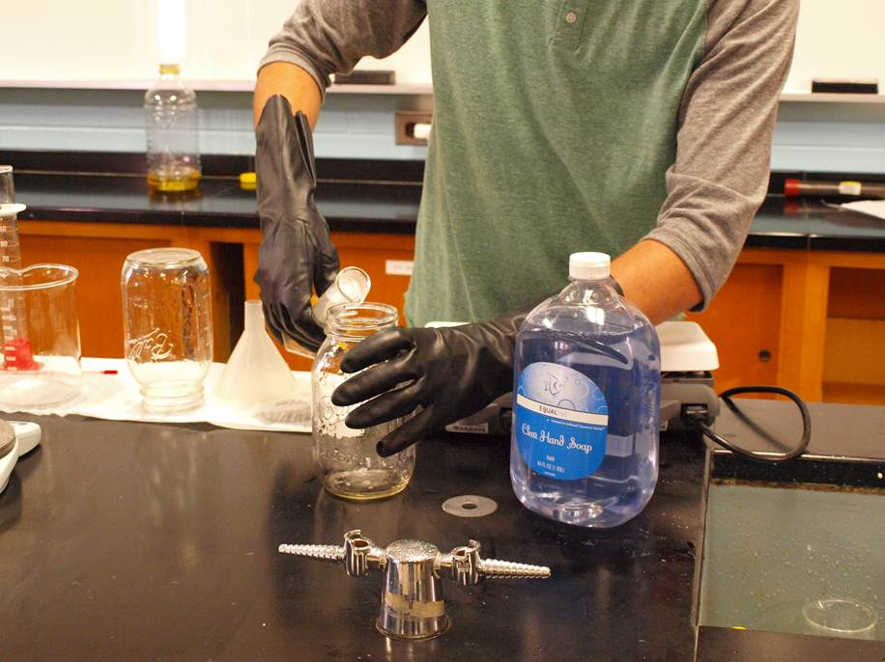
Completed Goals
Research
Construction
Algae collection
Biodiesel production
Informed the public
Working with others

Slide 22
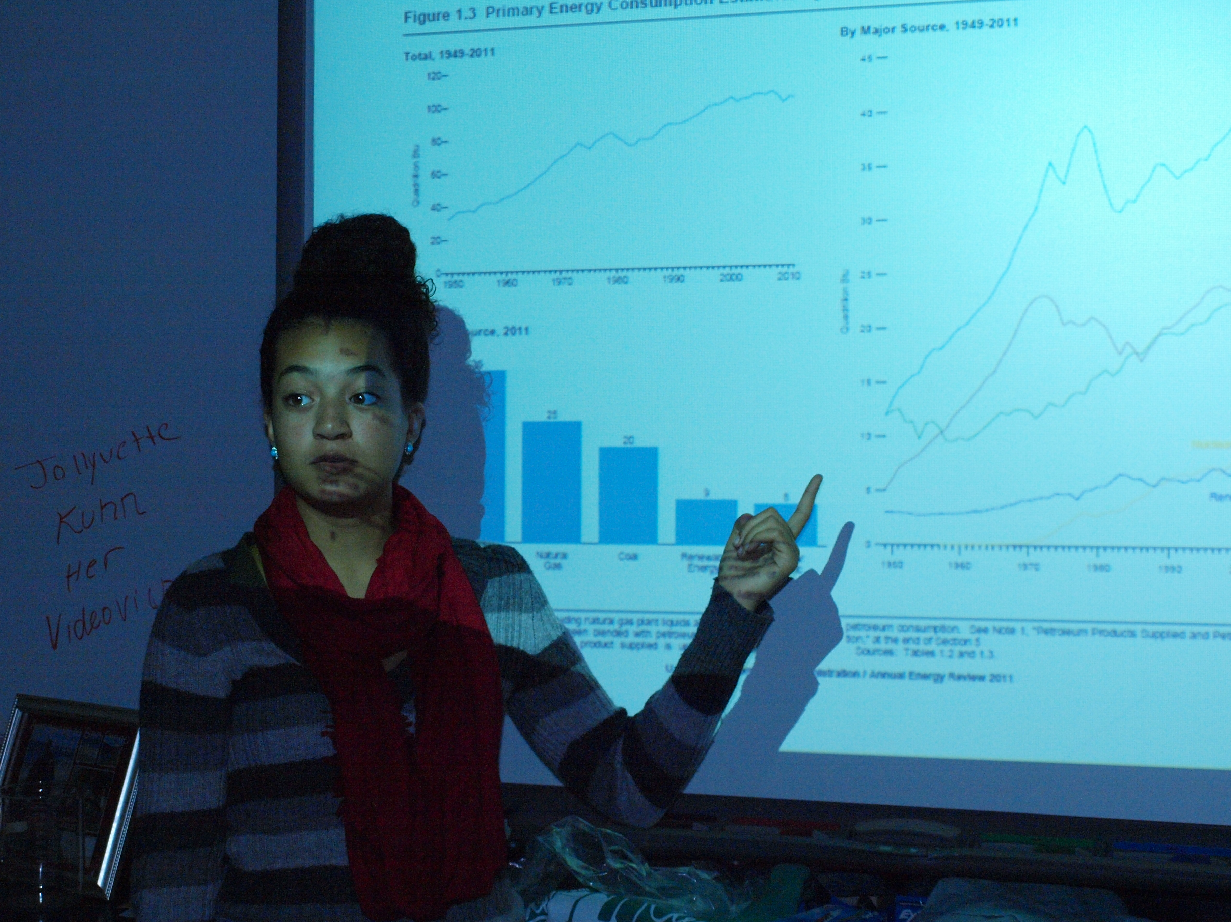
Completed Goals
Research
Construction
Algae collection
Biodiesel production
Informed the public
Working with others

Slide 23
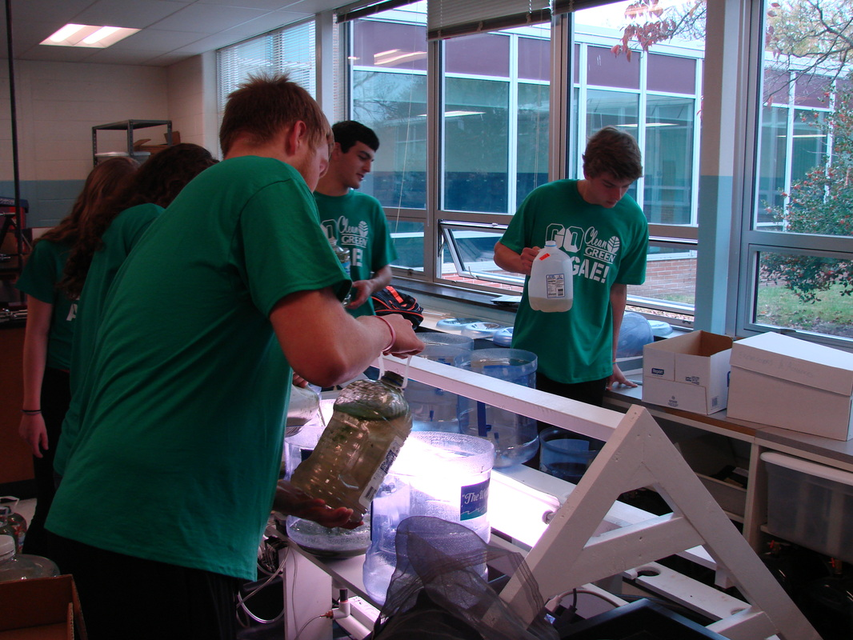
Completed Goals
Research
Construction
Algae collection
Biodiesel production
Informed the public
Working with others

Slide 24
Long Term Goals
Continuation
Juniors
Greenhouse
Grounds Keeping
Fertilizer
Fuel
School/Community involved

Slide 25
http://gocleangogreengoalgae.weebly.com/
Check out our website:
Follow us on Twitter:
https://twitter.com/GocleanGoalgae
Notes:
*website: we go in-depth on our mission, research, and community involvement
*website: include pictures and video links documenting our journey
*follow us on twitter: we will begin posting updates about our project and important information or breakthroughs

