Slide 1
Go Clean Go Green Go Algae
Research Project Presented by:
Daniel Boone High School Green Team

Slide 2
Year 1 Accomplishments: Research
Started as a research project
Researched best renewable energy
Solar
Hydroelectric
Geothermal
Wind
Biofuels
Corn-based ethanol
Palm-based biodiesel
Algae-based biofuel

Slide 3
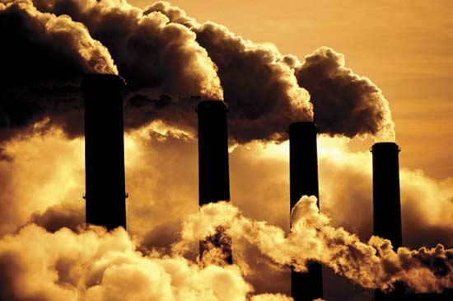
Fossil Fuels
Fuels composed of the organic remains of ancient plants and animals
Coal
Crude Oil (Petroleum)
Natural Gas
Advantages
High amounts of chemical energy
Infrastructure and drilling techniques are
well established.
Disadvantages
Nonrenewable
Pollution

Slide 4
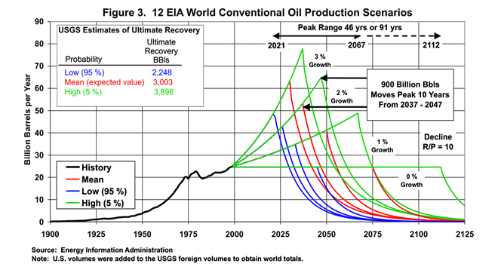
Limited Oil
Notes:
Problem occurs not when crude oil is gone, but when production rate falls below the demand.
All projections of this inevitable fate range between year 2040 and 2080
Projection from the DOE estimates that the demand for oil will be 41.9 billion barrels annually and production will fall to about 25 billion barrels annual being produced
A Deficit of 16 billion barrels!
Projections estimate that by 2020 greenhouse gas emissions will reduce by 17 percent and by 2050, 83 percent.

Slide 5
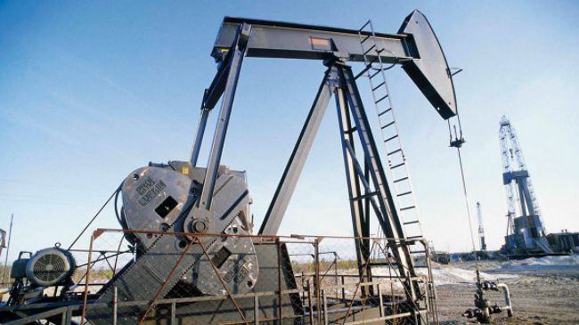
Limited Oil
President Obama FY 2014 budget seeks $638.0 million for the Office of Fossil Energy
This funding has been in place for many years
$420.6 million for research and development
$217.4 million for oil reserves

Slide 6
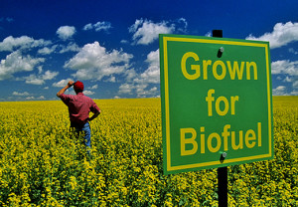
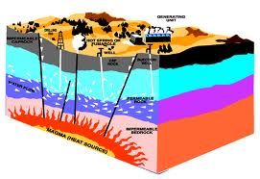
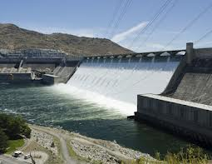
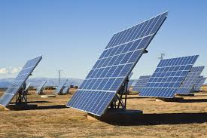
The Solution….
Renewable Energy!

Slide 7
Disadvantages of Ethanol
Corn inefficient source of biofuel
Limited by space, season
Decreases mileage
2/3 energy content of gasoline
E10 (10% ethanol) drops mileage by about 3% (EPA)
Damages Engines
Rust, other deposits picked up in gas station storage tanks gum up engines
Carbon Footprint
Reaction that produces ethanol yields one molecule of carbon dioxide per molecule of ethanol

Slide 8
Other Biofuels
Plant | Yields( gallons per acre per year)
Corn | 18
Soybeans | 48
Safflower | 83
Sunflower | 102
Rapeseed | 127
Palm | 623
Algae | 5,000-15,000

Slide 9
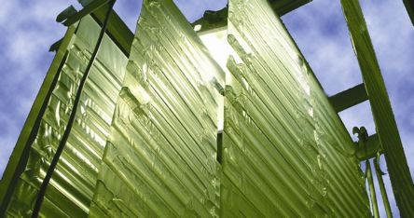
Benefits of Algae
Algae
Very efficient and fast producing source of fuel
Under optimal condition, can double quantity in 24 hours
Extremely abundant
Algae can produce approximately 100 times more fuel per acre than other renewable resources
Vertigro vs. Pond
Controlled vs. Open
Carbon Sequestering
Uses Carbon Dioxide from its environment
Reduces Carbon Dioxide emission by 50%-70%

Slide 10
Ethanol Subsidies
First subsidy: Energy Policy Act of 1978
2004 – 2011 Volumetric Ethanol Excise Tax Credit
45 cents per gallon
$6 billion annually
Renewable Fuel Standard
Requires at least 10% ethanol to be blended into gasoline and diesel

Slide 11
If the government can support ethanol…
…why can’t they support algae?

Slide 12
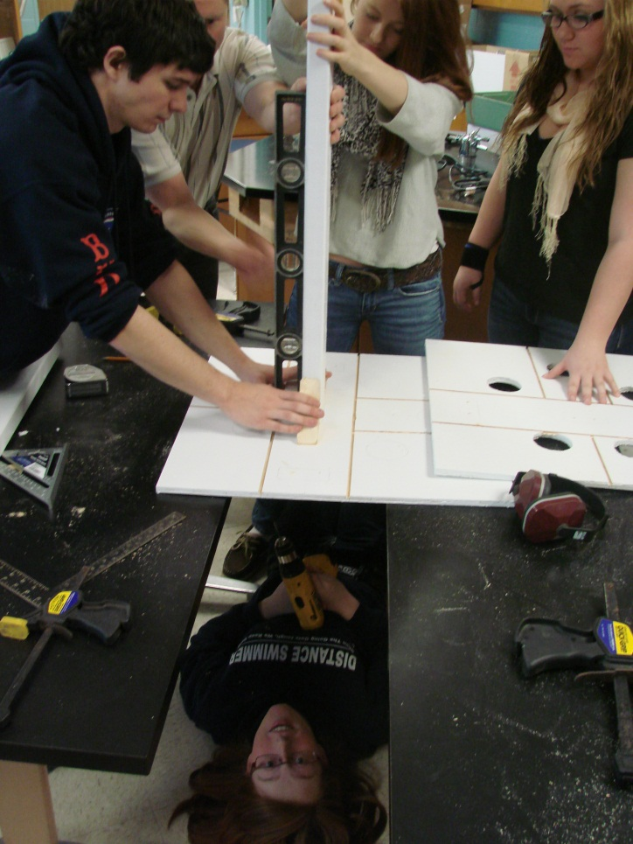
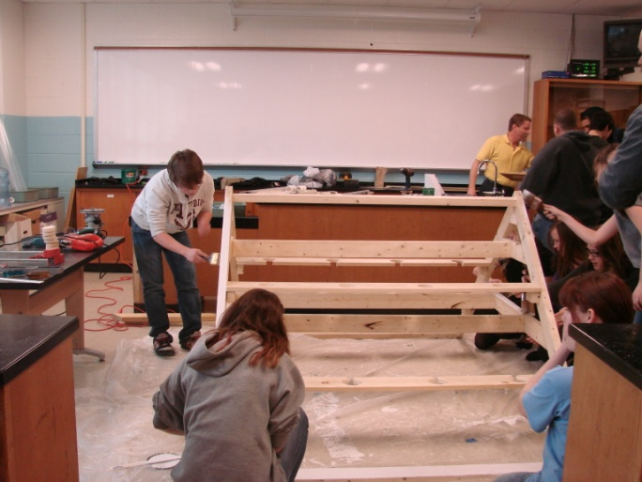
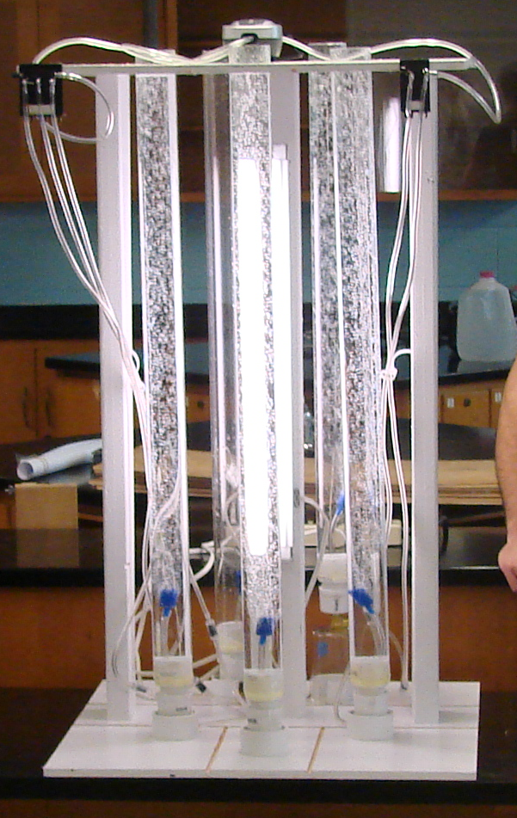
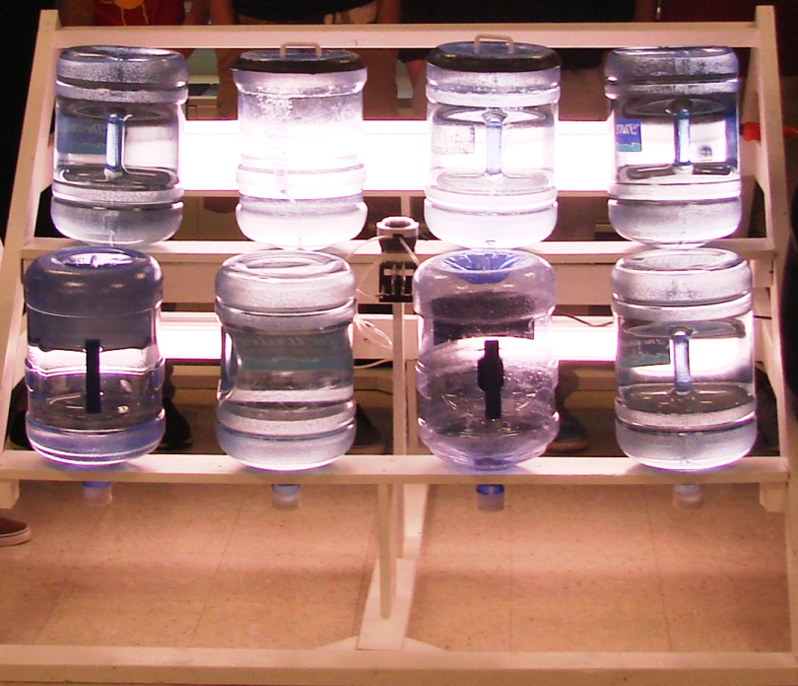
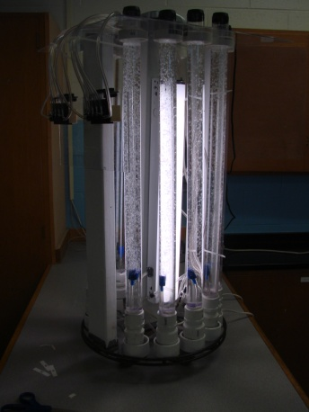
Year 1 Accomplishments: Construction
Two Design of Experiment Reactors
3 Liter Light Partition Reactors
1 Liter Variable Nutrient Reactors
A-Frame
Sixteen, 20 liter Reactors

Slide 13
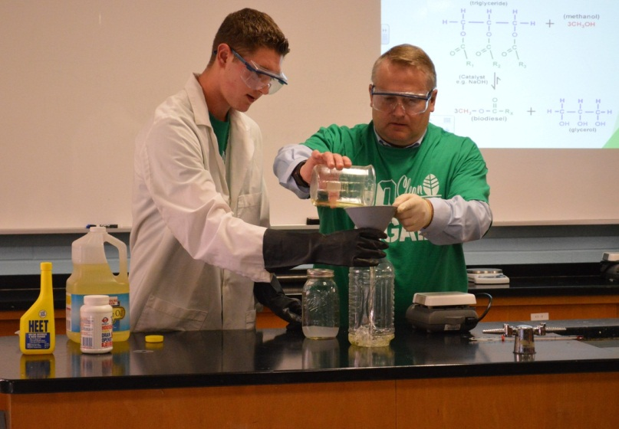
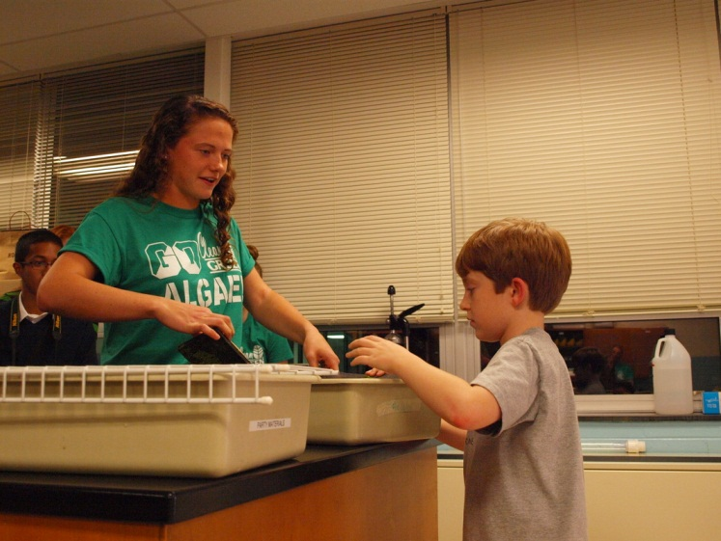
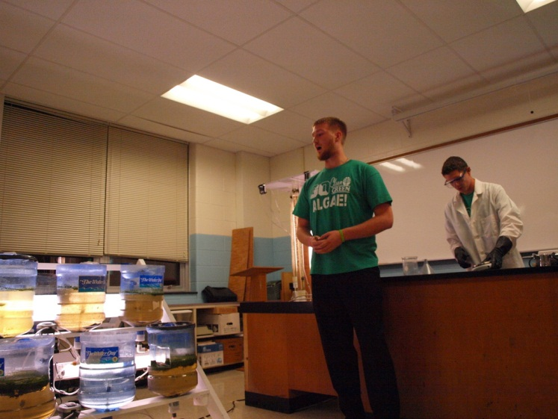
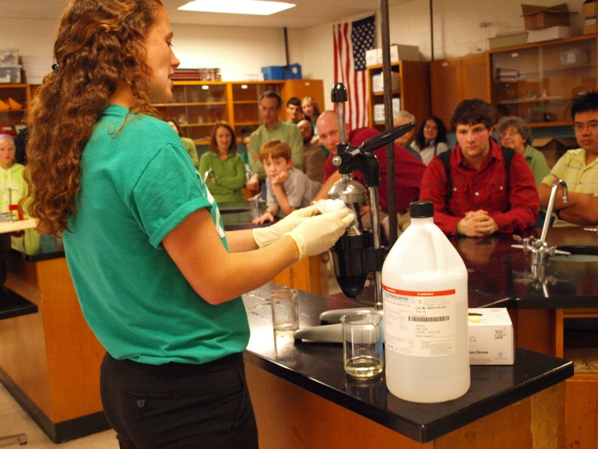
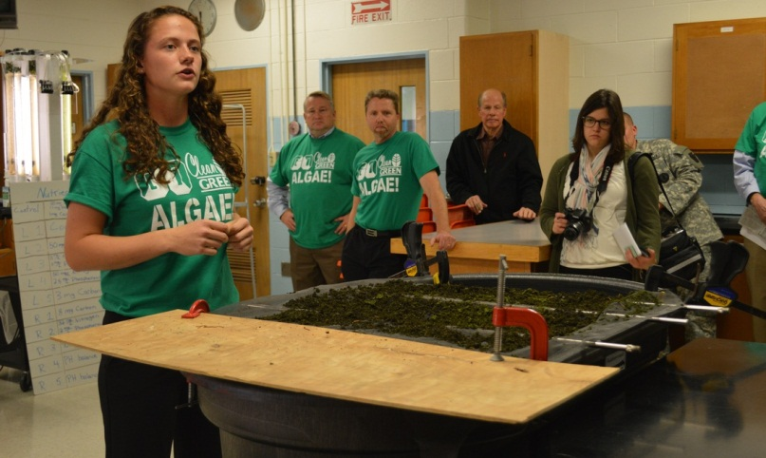
Year 2: Lexus Eco Challenge
Challenge 1: Air and Climate
Set up working relationship with college professors
Completed construction of original bioreactor designs
Bioreactor Premiere Night

Slide 14
Year 2: Lexus Eco Challenge
As a result of our premier night
Featured in 8 different articles in 5 different newspapers and publications
Contacted and supported by 3 international biotechnology companies
Reaching out to other Schools
First Place prize in East Coast Region

Slide 15
Year 2: Lexus Eco Challenge
Challenge 2: Final Challenge
Finalists form Challenge 1 compete for Grand Prize
One of 16 High School teams in the country
Goal: Educate the world about our research on algae based biofuels
1,500 emails sent to high school science teachers in all 50 states
Sent emails to high school science teachers in 10 different countries on 6 continents
Sent over 45 press releases to over 20 news organizations
Sent emails to every Pennsylvania State senator and representative
Sent emails to senators and representatives in neighboring states
Reached out to numerous environmentally friendly celebrities
Set up a website for an email campaign to inform President Obama of our research
Notes:
Animate each bullet coming in

Slide 16
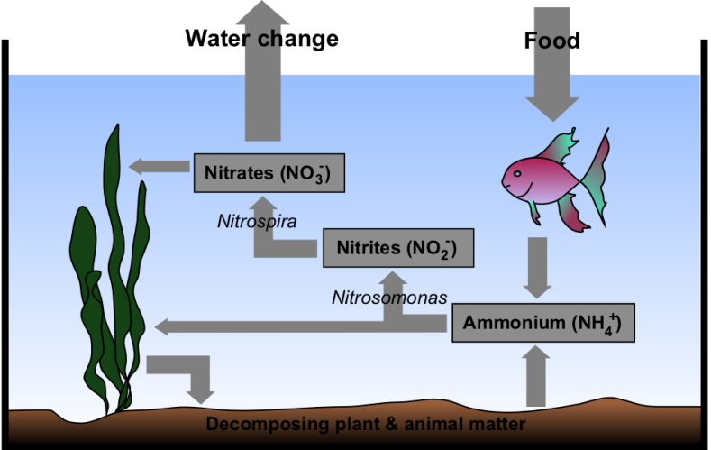
Three New Objectives 1. Water Chemistry
The Nitrogen cycle
A lack of nitrifying bacteria
High mortality rate of life in our bio-reactor
Nitrogen Cycle Correction Process
pH 5
Ammonia +12 (mg/L)
Nitrate .25 (mg/L)
Phosphate +12 (mg/L)

Slide 17
Three New Objectives 2. Oil Extraction Techniques
Supercritical Fluid Extraction
Supercritical fluids effuse through solids like a gas, dissolve materials like a liquid
Made by heating and applying pressure to a liquid or gas
Common supercritical fluids: water and carbon dioxide
Extraction Procedure
Pass supercritical fluid through algae cells at appropriate temperature and pressure
Lipid oils diffuse out of the cells with the help of the supercritical fluid solvent
Separate oils from supercritical fluid

Slide 18
Three New Objectives 2. Oil Extraction Techniques
Osmotic Shock
Osmosis – the movement of solvent molecules across a semipermeable membrane down a concentration gradient
Involves sudden changes in the solute concentration of the environment around a cell
Hypotonic Solution
Water overfills cell, cell membrane bursts
Releases oil, which can be collected

Slide 19
Three New Objectives 2. Oil Extraction Techniques
Ultrasonic Pulsation
Uses ultrasonic waves to break open cell walls and cell membranes
Certain frequencies of sound interact with liquids in the cells
Alternating high and low pressure waves cause cavities to rapidly form and implode in pulses
These implosions create high speed liquid jets that break cell walls and cell membranes
Once the walls and membranes are broken, oil can be extracted

Slide 20
Three New Objectives 3. Algae Strain Selection
Many strains are viable, but some perform better than others
High oil content is usually coupled with slower growth
Nutrient altering may lead to increased lipid content, but may have adverse effects
Marine strains are also viable but would require water transport

Slide 21
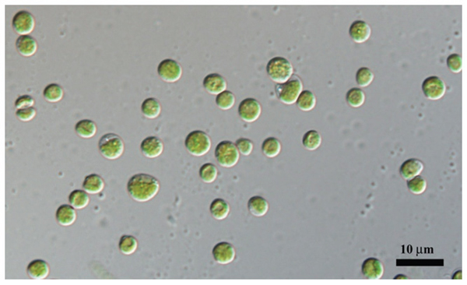
Three New Objectives 3. Algae Strain Selection
Chlorella Vulgaris
Derived from the Latin “Chloros” (green) and “Ella” (Small)
About 20% lipids, 45% Protein
High growth rate makes up for average lipid content
Up to 40% lipids can be obtained from nutrient deprivation
A doubling time of about 2 days on average
Other species of Chlorella are also viable for biodiesel production

Slide 22
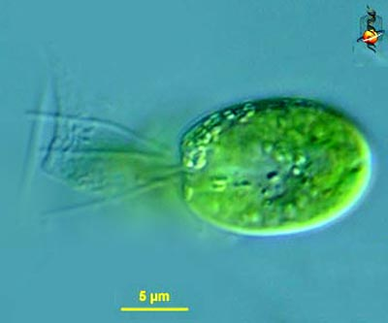
Three New Objectives 3. Algae Strain Selection
Tetraselmis S.
Singular motile marine green alga cells
May grow up to 1 Mil cells per Milliliter
15%-30% lipids in dry biomass
About 2 day doubling time
From a genus of phytoplankton

Slide 23
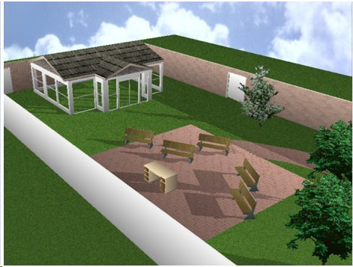
Year 3: Goals
Lorie Kemp Memorial Green Classroom
Dedication
Relay for Life
Brick Pathway Dedication
Stage Platform
Greenhouse
Research Lab with increased capacity
Oil extraction Process
Algae Species
Water Chemistry Improvements
Notes:
Insert courtyard pictures

Slide 24
Year 4: Goals
Develop Honors and AP Environmental Science Program
Earth systems and resources
Land and Water use
Energy Resources and Consumption
Pollution and Global Change
Partner with universities/ professors
Approached by 2 Universities to work collaboratively
Start patent process for oil extraction process from year 3
Alternative and Clean Energy Program
Loans up to $40,000
development and construction of alternative and clean energy projects in PA

Slide 25
Year 5: Goals
Continued partnership with Local Universities
Look for additional partners
Expand lab capabilities to collegiate levels
Apply for accreditation with partnered colleges
Develop lab reciprocities so high school and college students can earn credits at satellite locations

Slide 26
We are not stopping here!
We are also presenting our research to:
White House Energy Advisor
Senate Committee
Algae Program Manager in the Bioenergy Technologies Office in the Department of Energy

Slide 27
Potential Grants from PA DOE
Alternative Fuels Incentive Act
Offers funding for clean, alternative fuel
PA Clean Diesel Program
Decrease emissions from diesel–powered vehicles
Replace/re-power vehicles
PA Energy Development Authority
Finance clean energy projects in PA
EE Grants Program
Support and strengthen environmental education

Slide 28
Potential Grants from PA DOE
Partnered with US Environmental Protection Agency
EE Act 1993
PA Biomass Energy Association
High Performance Green Schools Planning
Governor’s Green Government Council

Slide 29
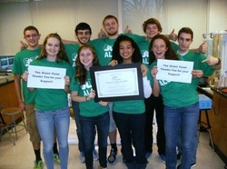
Thank you!
www.GoCleanGoGreenGoAlgae.weebly.com
Twitter: @GoCleanGoAlgae

Slide 30
Evolution of Technology
ENIAC built in 1946
ENIAC was 8 x 3 x 100 Feet, or 1,800 sqft., About the size of a medium house.
ENIAC cost $500,000 then ($6,000,000 in 2013)
Average computer today, $400+
Motorola DynaTAC (First Portable Cell Phone) built in 1983
Lovingly Called "The Brick"
Weighed over a pound and a half
First sold for $3,995 ($9,363 today)
Only had ten digit display and had a detachable antenna

Slide 31
US Department of Energy’s Grants
$21 million given to 5 projects
Develop systems to aid biofuel production
Advancing harvesting, collecting, processing, transport, storage, etc.
Goals:
To reduce dependency on foreign oil
Grow a domestic bio-industry
Create more jobs

Slide 32
Grants Awarded To:
Agco Corporation of Duluth
large square bale
Auburn University
Forest Biomass
FDC Enterprises Inc.
Feedstocks (switchgrass, miscanthus, energycane, sorghum, poplar, willow)
Genera Energy
Switchgrass
SUNY College of Environmental Science
Short- rotation wood crops
Notes:
WHY NOT ADD THE ALGAE BIOFUEL INDUSTRY. I.E. US!

Slide 33
Inefficiency
Biofuel potential is limited in these grants because of:
Low yield content
Restricted optimal climate
Seasonal
Availability
Notes:
PROBLEMS WITH THE BIOFUELS THESE PROJECTS COINSIDE WITH
This slide maybe unnecessary

Slide 34
Efficiency
Aiding algae biofuel development
Notes:
THIS SLIDE MAY NOT BE NEEDED

